Slide 1
8279 PROGRAMMABALE KEYBOARD/DISPLAY INTERFACE
8279 is a h/w approach to interface a matrix keyboard and multiplexed display.
WHY
Because s/w approach has following disadvantages
->more time for checking the keyboard and refreshing the delay.
8279 relieves the processor from these two tasks but the disadvantage is more cost

Slide 2
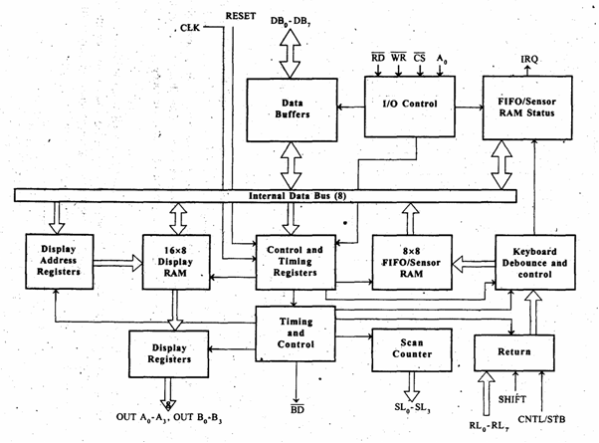

Slide 3
8279 is a 40 pin device with four segments.
-Keyboard
-Scan
-Display
-MPU interface

Slide 4
Keyboard Section
It has 8 lines (RL0-RL7) connected to 8 columns of a keyboard
Two additional lines Shift and CNTL/STB
the status of these two keys stored along with a key closure.
Keyboard can operate in two modes
two-key lockout
N-key rollover

Slide 5
Two-key lockout
If two keys are pressed simultaneously , only the first key is recognized.
N-key rollover
Simultaneous keys are recognized and their codes are stored in the internal buffer .
It can also be set up so that no key is recognized until only one key remains pressed

Slide 6
Keyboard section includes 8X8 FIFO RAM.
Status logic keeps track of the no of entries and provides an IRQ (Interrupt Request) when the FIFO is not empty.

Slide 7
Scan Section
It has a scan counter and 4 scan lines (SL0-SL3)
Scan lines are decoded using 4-to-16 decoder to generate 16 lines for scanning.
Scan lines are connected to the rows of a matrix keyboard

Slide 8
Display Section
It has 8 output lines divided into 2 groups A0-A3 and B0-B3
It can be blanked using BD line
It includes 16X8 display RAM

Slide 9
MPU interface section
It includes 8 bidirectional lines DB0-DB7 , one IRQ line and 6 lines for interfacing.
When A0 is high signals are interpreted as control words or status
When A0 is low signals are interpreted as data.
IRQ signal is used to interrupt the MPU to indicate the availability of data.

Slide 10
Serial Data Standard RS 232 C
It is used when data is transmitted as Voltage.
It is defined in reference to DTE and DCE (terminal and modem).
It is a 25-pin connector.
Its signals divided into four groups
data, control , timing and ground

Slide 11
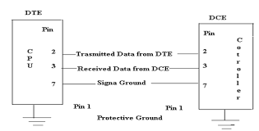

Slide 12
The minimum interface b/w a computer and a peripheral requires 3 lines: pins 2,3 and 7.
DTE transmits on pin 2 and receives on pin 3
DCE transmits on pin 3 and receives on pin 2
Pin 7 is ground signal

Slide 13
Data transmission with a handshake requires 8 lines :
Pin2 - Transmit data
pin3 - Receive data
Pin4 - Request to Send
Pin5 – Clear to Send
Pin6 – Data Set Ready
Pin7 – Signal Ground
Pin8 – Data Carrier Detect
Pin20 – Data Terminal Ready

Slide 14
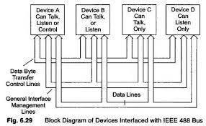
Parallel Data Standard IEEE 488

Slide 15
IEEE-488 refers to the Institute of Electrical & Electronics Engineers (IEEE) standard number 488.
IEEE-488 is a digital communications bus specification invented by Hewlett Packard and used to connect short range communication devices.
This term is also known as the general purpose interface bus (GPIB) or the Hewlett Packard interface bus (HP-IB).

Slide 16
Key features or Important information about IEEE 488 (GPIB)
In the 1960s, Hewlett Packard developed IEEE 488 to easily interconnect controllers and instruments.
As a short range communication bus, IEEE 488 was easy to connect and configure.
The IEEE 488 has a 24-pin connector and is used for double headed design. Both ends of the cable are used, male on one side and female on other side.

Slide 17
The IEEE 488 has 16 signal lines. Eight lines are dedicated for bi-directional communication , five lines are used for bus management. The remaining three lines are dedicated for handshakes.
This allows 15 devices to be shared over a single physical bus.
The maximum data rate is about 1 MB/sec .
Communication is digital & messages are sent one byte (8 bits) at a time.
Manage transactions are hardware handshake.
Total bus length may be up to 20m & the distance between devices may be up to 2m

Slide 18
THANK YOU

